Slide 1
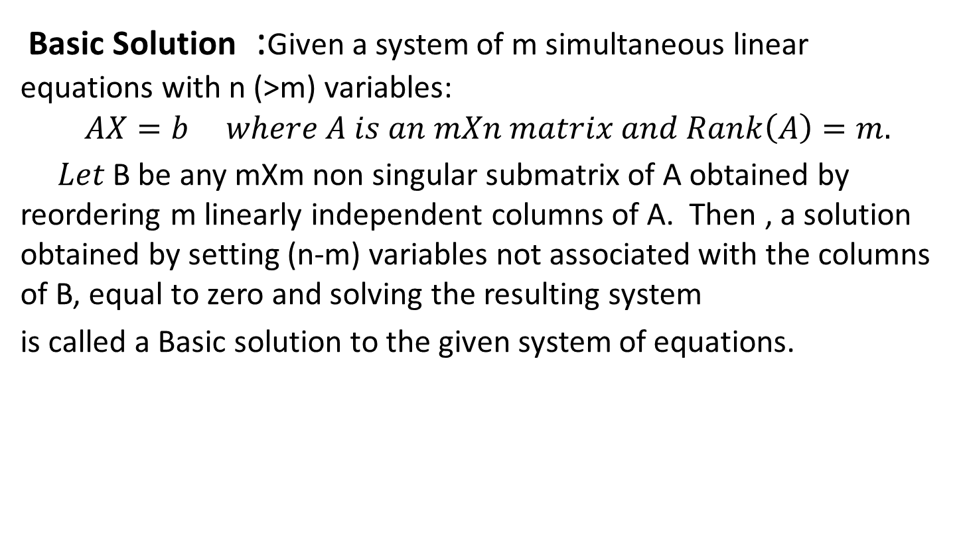
DEFINITIONS
Basic Solution :Given a system of m simultaneous linear equations with n (>m) variables:
$$AX=b where A is an mXn matrix and Rank\left(A\right)=m.$$
$Let$B be any mXm non singular submatrix of A obtained by reordering m linearly independent columns of A. Then , a solution obtained by setting (n-m) variables not associated with the columns of B, equal to zero and solving the resulting system
is called a Basic solution to the given system of equations.

Slide 2

Remarks
A basic solution has the following properties:
Each variable is designated as either a non basic variable or a basic variable.
The number of basic variables equals the number of functional constraints. Therefore, the number of non basic variables equals the total number of variables minus the number of functional constraints.
The non basic variables are set equal to zero.
There are at most

Slide 3
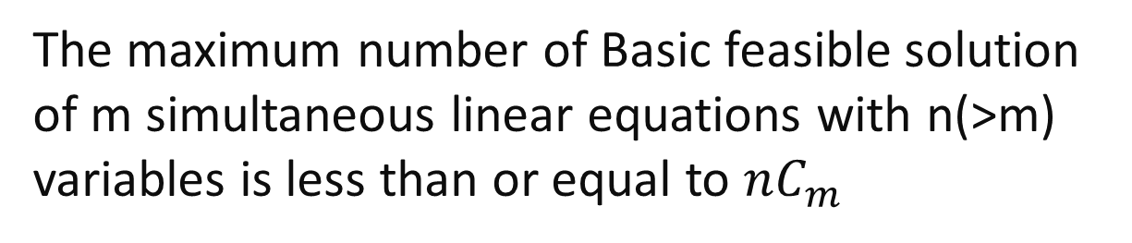
Basic Feasible Solution(BFS) :A Basic solution to the system of simultaneous equations is said to be Basic Feasible Solution if all the values are non negative.
A basic feasible solution is correspond to a corner point of the Feasible Region of LPP.
The maximum number of Basic feasible solution of m simultaneous linear equations with n(>m) variables is less than or equal to $nC_{m}$

Slide 4
Degenerate Basic Feasible Solution :
A BFS to the system of equations is called degenerate if one or more of the basic variables values equal to zero.
Non-Degenerate Basic Feasible Solution:
A BFS is called non-degenerate BFS if values of all basic variables are positive.

Slide 5
Algebraic Method to solve LPP
Assume all the constraints are equations in the given LPP
2. Find the Basic Solution
Determine the Basic Feasible
solution(BFS)
4. Determine the Optimum BFS of LPP by using the objective function of the LPP

Slide 6
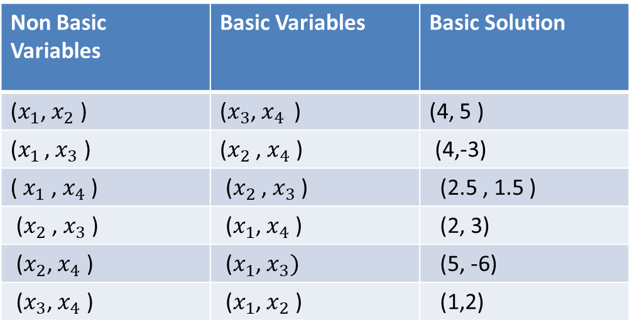

Example for obtaining Basic Solution
Consider the following system of equations:
$2x_{1}$+$x_{2}$+$x_{3}$=4
$x_{1}$+2$x_{2}$ +$x_{4}$=5 and $x_{1}$,$x_{2}$,$x_{3}$,$x_{4}$≥0
The following Table provides all the Basic solutions:
Non Basic Variables | Basic Variables | Basic Solution
($x_{1}$, $x_{2}$ ) | ($x_{3}$, $x_{4 }$ ) | (4, 5 )
($x_{1 }$, $x_{3}$ ) | ($x_{2}$ , $x_{4}$ ) | (4,-3)
( $x_{1}$ , $x_{4}$ ) | ($x_{2}$ , $x_{3}$ ) | (2.5 , 1.5 )
($x_{2}$ , $x_{3}$ ) | ($x_{1}$, $x_{4}$ ) | (2, 3)
($x_{2}$, $x_{4}$ ) | ($x_{1}$, $x_{3})$ | (5, -6)
($x_{3}$, $x_{4}$ ) | ($x_{1}$, $x_{2}$ ) | (1,2)

Slide 7
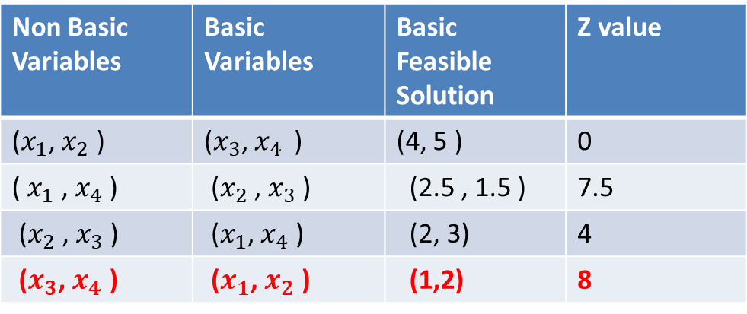

Example for Solving LPP By Algebraic Method
Consider the following LPP:
Maximize Z=${2x}_{1}$+ 3$x_{2}$+0$x_{3}$+0$x_{4}$
Subject to
$2x_{1}$+$x_{2}$+$x_{3}$=4
$x_{1}$+2$x_{2}$ +$x_{4}$=5 and $x_{1}$,$x_{2}$,$x_{3}$,$x_{4}$≥0
The following Table provides all the Basic feasible solutions:
Non Basic Variables | Basic Variables | Basic Feasible Solution | Z value
($x_{1}$, $x_{2}$ ) | ($x_{3}$, $x_{4 }$ ) | (4, 5 ) | 0
( $x_{1}$ , $x_{4}$ ) | ($x_{2}$ , $x_{3}$ ) | (2.5 , 1.5 ) | 7.5
($x_{2}$ , $x_{3}$ ) | ($x_{1}$, $x_{4}$ ) | (2, 3) | 4
($x_{3}$, $x_{4}$ ) | ($x_{1}$, $x_{2}$ ) | (1,2) | 8

Slide 8
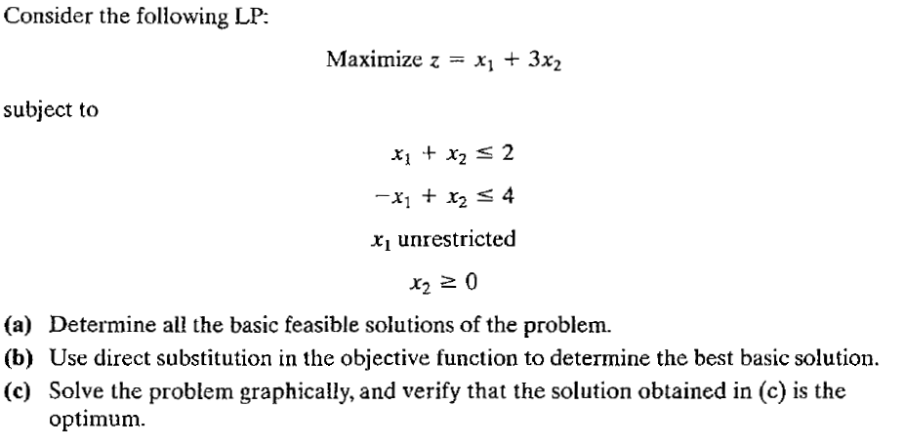
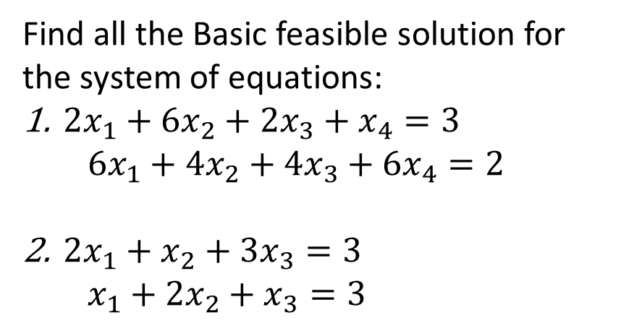
PRACTICE PROBLEMS
Find all the Basic feasible solution for the system of equations:
$2x_{1}+6x_{2}+2x_{3}+x_{4}=3$
$6x_{1}+4x_{2}+4x_{3}+6x_{4}=2$
$2x_{1}+x_{2}+3x_{3}=3$
$x_{1}+2x_{2}+x_{3}=3$
3.

Slide 9
DEFINITIONS
Slack Variable: The non-negative variables which are added to LHS of the constraints to convert them into equalities are known as slack variables.
For constraints of the type ( ≤ ), the right hand side normally represents the limit on the availability of a resource and the left hand side represents the usage of this limited resources by the different activities(variables) of the model. A slack variable represents the amount by which the available amount of resources exceeds its usage by the activities.

Slide 10
Surplus Variable: The non-negative variables which are subtracted from the LHS of the constraints to convert them into equalities are known as surplus variables.
For Constraints of the type (≥) normally set minimum specification requirements. In this case, a surplus variable represents the excess of the left hand side over the minimum requirement
Remark: Slack and Surplus variables carry a zero coefficient in the objective function.

Slide 11
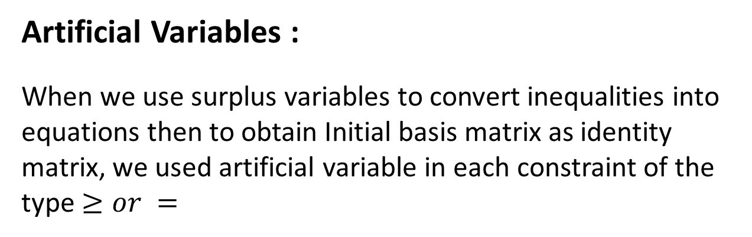
Artificial Variables :
When we use surplus variables to convert inequalities into equations then to obtain Initial basis matrix as identity matrix, we used artificial variable in each constraint of the type $≥or =$
Remark : The coefficient of artificial variables in the objective function is
+M for Minimization
-M for Maximization, M>0

Slide 12
STANDARD FORM OF LPP The standard form of the LP Problem should have the following characteristics: 1) All the constraints are equations with nonnegative right hand side value 2) All the decision variables are non negative 3) The objective function is either maximization or minimization type

Slide 13
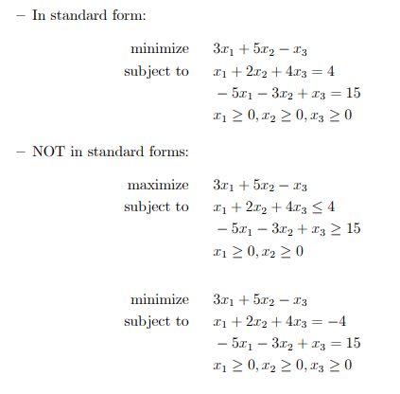

Slide 14
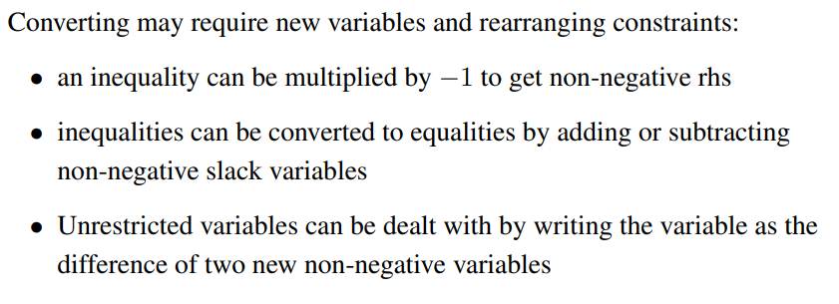
Examples :

Slide 15
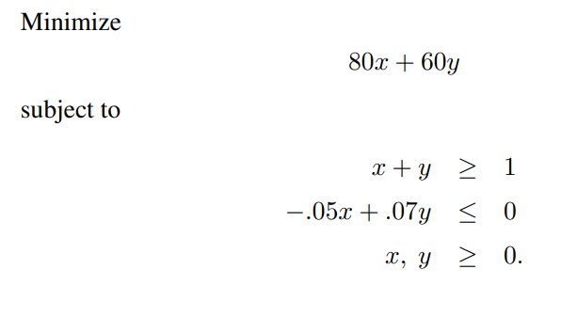
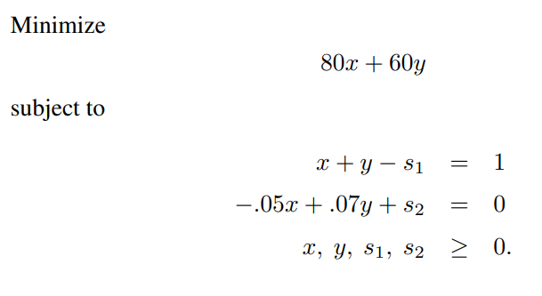

Slide 16
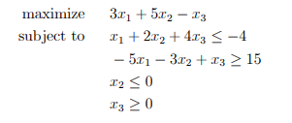

Slide 17
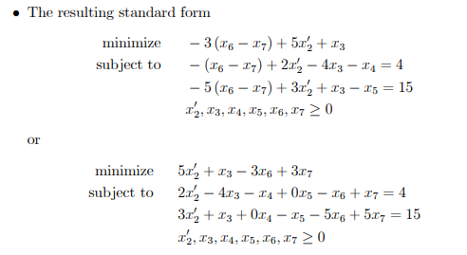

Slide 18
Introduction of Simplex Method
Simplex Method: It is a linear-programming algorithm that can solve problems having any number of decision variables.
The simplex technique involves generating a series of solutions in tabular form, called tableaus. By inspecting the bottom row of each tableau, one can immediately tell if it represents the optimal solution. Each tableau corresponds to a corner point of the feasible solution space. The first tableau corresponds to the origin. Subsequent tableaus are developed by shifting to an adjacent corner point in the direction that yields the highest (smallest) rate of profit (cost). This process continues as long as a positive (negative) rate of profit (cost) exists.

Slide 19
The simplex method in tabular form
Steps:
1. Initialization:
a. Transform all the constraints to equality by introducing slack, surplus, and artificial variables as follows:
Constraint type | Variable to be added
≤ | + slack (s)
≥ | - Surplus (s) + artificial (A)
= | + Artificial (A)

Slide 20
Simplex method in tabular form
b. Construct the initial simplex tableau
Basic variable | X₁ | … | X_{n} | S₁ | …... | S_{n} | A₁ | …. | A_{n} | RHS
S | Coefficient of the constraints |  |  |  |  |  |  |  |  | b₁
A |  |  |  |  |  |  |  |  |  | b_{m}
Z | Objective function coefficient In different signs |  |  |  |  |  |  |  |  | Z value

Slide 21
Simplex method in tabular form
2. Test for optimality:
Case 1: Maximization problem
The current BF Solution is optimal if every coefficient in the objective function row is non negative
Case 2: Minimization problem
The current BF Solution is optimal if every coefficient in the objective function row is non positive

Slide 22
Simplex method in tabular form
3. Iteration
Step 1: Determine the entering variable by selecting the variable (automatically a non basic variable) with the most negative value (in case of maximization) or with the most positive (in case of minimization) in the last row (Z-row). Put a box around the column below this variable, and call it the “pivot column”

Slide 23
Simplex method in tabular form
Step 2: Determine the leaving basic variable by applying the minimum ratio test as following:
1. Pick out each coefficient in the pivot column that is strictly positive (>0)
2. Divide each of these coefficients into the right hand side entry for the same row
3. Identify the row that has the smallest of these ratios
4. The basic variable for that row is the leaving variable, so replace that variable by the entering variable in the basic variable column of the next simplex tableau. Put a box around this row and call it the “pivot row”

Slide 24
Step 3: Update the Simplex table
Find the new BF solution by using elementary row operations (multiply or divide a row by a nonzero constant; add or subtract a multiple of one row to another row) to construct a new simplex tableau, and then go to the Step 2.
The specific elementary row operations(Gauss-Jordan) are:
1. New pivot row = old pivot row ÷ Pivot Element
Other New row = old row – [(the coefficient of this row in the pivot column) x (new pivot row)]

Slide 25



Example 1 to solve LP using SIMPLEX METHOD
Consider the previously discussed Fruit-Seller’s Problem.
LP Model 1
$$Maximize Z=6x_{1}+10x_{2}$$
Subject to
$$25x_{1}+50x_{2}≤500$$
$$x_{1} +{ x}_{2} ≤12$$
$$x_{1} ≥0,x_{2}≥0$$

Slide 26




SOLUTION TO LP MODEL 1
Standard Form: In this case all constraints are $≤$ type constraints. $S_{1}$ and $S_{2}$ are slack variables
$$Maximize Z=6x_{1}+10x_{2}+0S_{1}+0S_{2}$$
Subject to
$$25x_{1}+50x_{2}+S_{1}=500$$
$$x_{1} +{ x}_{2}+S_{2}=12$$
$$x_{1} ≥0,x_{2}≥0$$

Slide 27


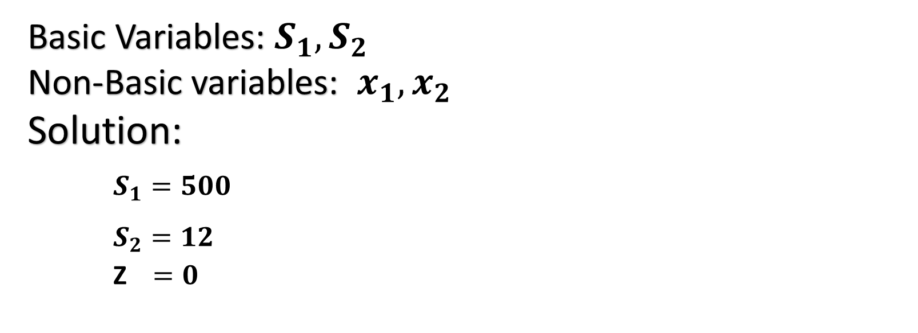

ITERATION 1
$$Maximize Z=6x_{1}+10x_{2}+0S_{1}+0S_{2}$$
Subject to
$$25x_{1}+50x_{2}+S_{1}=500$$
$$x_{1} +{ x}_{2}+S_{2}=12$$
$$x_{1} ≥0,x_{2}≥0$$
Basic Variables: $S_{1},S_{2}$
Non-Basic variables: $x_{1},x_{2}$
Solution:
$S_{1}=500$
$S_{2}=12$
Z $=0$

Slide 28
ITERATION 1
Entering variable
Basic variable | X₁ | X₂ | S₁ | S₂ | RHS
S₁ | 25 | 50 | 1 | 0 | 500
S₂ | 1 | 1 | 0 | 1 | 12
Z | -6 | -10 | 0 | 0 | 0
Ratio
10
12
Least Positive Ratio
Leaving variable
Pivot row
Pivot column
Pivot Element

Slide 29
Optimality test
By investigating the last row of the initial tableau, we find that there are some negative numbers. Therefore, the current solution is not optimal

Slide 30
Finding the new Basic Feasible solution by using the eliminatory row operations (Gauss-Jordan ) as following.
New pivot row = old pivot row ÷ Pivot Element
= Old Pivot Row ÷ 50
2. New row = old row – [the coefficient of this row in the pivot column *(new pivot row)]
Basic variable | X₁ | X₂ | S₁ | S₂ | RHS
x₂ | 0.50 | 1 | 0.02 | 0 | 10
S₂
Z
Note that X₂ becomes in the basic variables list instead of S₁

Slide 31
ITERATION 2
Entering variable
Basic variable | X₁ | X₂ | S₁ | S₂ | RHS
x₂ | 0.50 | 1 | 0.02 | 0 | 10
S₂ | 0.50 | 0 | -0.02 | 1 | 2
Z | -1 | 0 | 0.20 | 0 | 100
Ratio
20
4
Least Positive Ratio
Leaving variable
Pivot row
Pivot column
Pivot Element

Slide 32
Optimality test
By investigating the last row of the tableau, we find that there are some negative numbers. Therefore, the current solution is not optimal

Slide 33
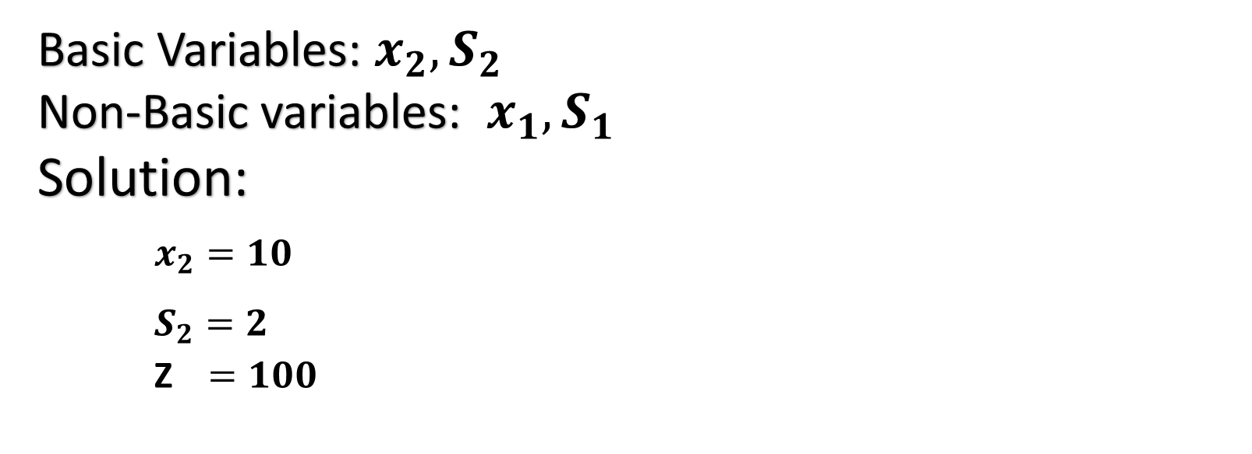
ITERATION 2
Basic Variables: $x_{2},S_{2}$
Non-Basic variables: $x_{1},S_{1}$
Solution:
$x_{2}=10$
$S_{2}=2$
Z $=100$

Slide 34
ITERATION 3
Basic variable | X₁ | X₂ | S₁ | S₂ | RHS
x₂ | 0 | 1 | 0.04 | -1 | 8
x₁ | 1 | 0 | -0.04 | 2 | 4
Z | 0 | 0 | 0.16 | 2 | 104
Since Optimality condition is satisfied, Iteration 3 is Optimal.

Slide 35
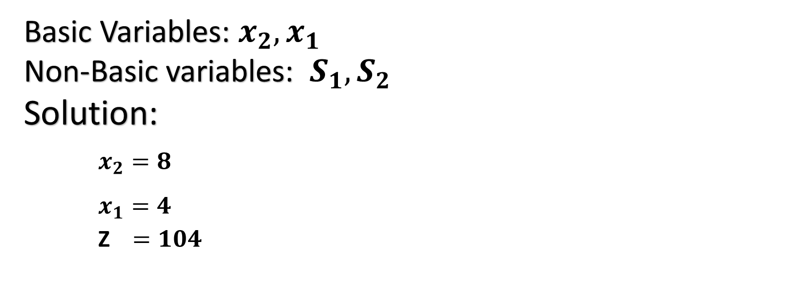
ITERATION 3
Basic Variables: $x_{2},x_{1}$
Non-Basic variables: $S_{1},S_{2}$
Solution:
$x_{2}=8$
$x_{1}=4$
Z $=104$

Slide 36
Simplex method
Example 2
Solve the following problem using the simplex method
Maximize Z = 3X₁+ 5X₂
Subject to
X₁ ≤ 4
2 X₂ ≤ 12
3X₁ +2X₂ ≤ 18
X₁ , X₂ ≥ 0

Slide 37
Simplex method
Solution
Initialization
Standard form
Maximize Z,
Subject to
Z - 3X₁- 5X₂ = 0
X₁ + S₁ = 4
2 X₂+ S₂ =12
3X₁ +2X₂+ S₃=18
X₁ , X₂, S₁, S₂, S₃ ≥ 0
Sometimes it is called the augmented form of the problem because the original form has been augmented by some supplementary variables needed to apply the simplex method

Slide 38
Initial tableau
Entering variable
2. Initial tableau
Basic variable | X₁ | X₂ | S₁ | S₂ | S₃ | RHS
S₁ | 1 | 0 | 1 | 0 | 0 | 4
S₂ | 0 | 2 | 0 | 1 | 0 | 12
S₃ | 3 | 2 | 0 | 0 | 1 | 18
Z | -3 | -5 | 0 | 0 | 0 | 0
Leaving variable
Pivot row
Pivot column
Pivot number

Slide 39
Simplex tableau
Notes:
The basic feasible solution at the initial tableau is (0, 0, 4, 12, 18) where:
X₁ = 0, X₂ = 0, S₁ = 4, S₂ = 12, S₃ = 18, and Z = 0
Where S₁, S₂, and S₃ are basic variables
X₁ and X₂ are nonbasic variables
The solution at the initial tableau is associated to the origin point at which all the decision variables are zero.

Slide 40
Optimality test
By investigating the last row of the initial tableau, we find that there are some negative numbers. Therefore, the current solution is not optimal

Slide 41
Iteration
Step 1: Determine the entering variable by selecting the variable with the most negative in the last row.
From the initial tableau, in the last row (Z row), the coefficient of X₁ is -3 and the coefficient of X₂ is -5; therefore, the most negative is -5. consequently, X₂ is the entering variable.
X₂ is surrounded by a box and it is called the pivot column

Slide 42
Iteration
Step 3: solving for the new BF solution by using the eliminatory row operations as following:
New pivot row = old pivot row ÷ pivot number
Basic variable | X₁ | X₂ | S₁ | S₂ | S₃ | RHS
S₁
X₂ | 0 | 1 | 0 | 1/2 | 0 | 6
S₃
Z
Note that X₂ becomes in the basic variables list instead of S₂

Slide 43
Iteration
2.For the other row apply this rule:
New row = old row – (the coefficient of this row in the pivot column) X (new pivot row).
For S₁
1 0 1 0 0 4
-
0 (0 1 0 1/2 0 6)
1 0 1 0 0 4
For S₃
3 2 0 0 1 18
-
2 (0 1 0 1/2 0 6)
3 0 0 -1 1 6
for Z
-3 -5 0 0 0 0
-
-5(0 1 0 1/2 0 6)
-3 0 0 5/2 0 30
Substitute this values in the table

Slide 44
Iteration
This solution is not optimal, since there is a negative numbers in the last row
Basic variable | X₁ | X₂ | S₁ | S₂ | S₃ | RHS
S₁ | 1 | 0 | 1 | 0 | 0 | 4
X₂ | 0 | 1 | 0 | 1/2 | 0 | 6
S₃ | 3 | 0 | 0 | -1 | 1 | 6
Z | -3 | 0 | 0 | 5/2 | 0 | 30
The smallest ratio is 6/3 =2; therefore, S₃ is the leaving variable
The most negative value; therefore, X₁ is the entering variable

Slide 45
Iteration
This solution is not optimal, since there is a negative numbers in the last row
Basic variable | X₁ | X₂ | S₁ | S₂ | S₃ | RHS
S₁ | 1 | 0 | 1 | 0 | 0 | 4
X₂ | 0 | 1 | 0 | 1/2 | 0 | 6
S₃ | 3 | 0 | 0 | -1 | 1 | 6
Z | -3 | 0 | 0 | 5/2 | 0 | 30
The smallest ratio is 6/3 =2; therefore, S₃ is the leaving variable
The most negative value; therefore, X₁ is the entering variable

Slide 46

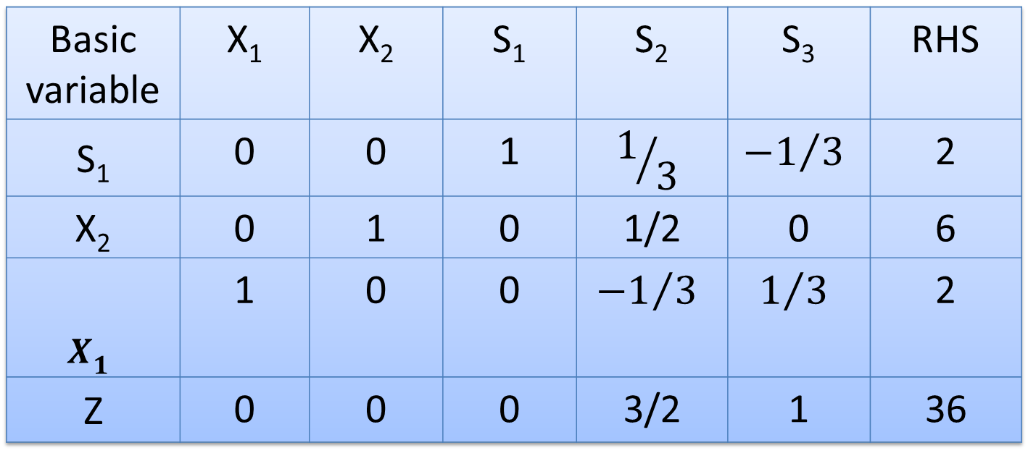
Iteration
Basic variable | X₁ | X₂ | S₁ | S₂ | S₃ | RHS
S₁ | 0 | 0 | 1 | $$1/3$$ | $${−1}/3$$ | 2
X₂ | 0 | 1 | 0 | 1/2 | 0 | 6
$$X_{1}$$ | 1 | 0 | 0 | $${−1}/3$$ | $$1/3$$ | 2
Z | 0 | 0 | 0 | 3/2 | 1 | 36
This solution is optimal, since there is a no negative numbers in the last row. Optimal BFS : $X_{1}$=2, $X_{2}$=6 with Maximum value Z=36

Slide 47
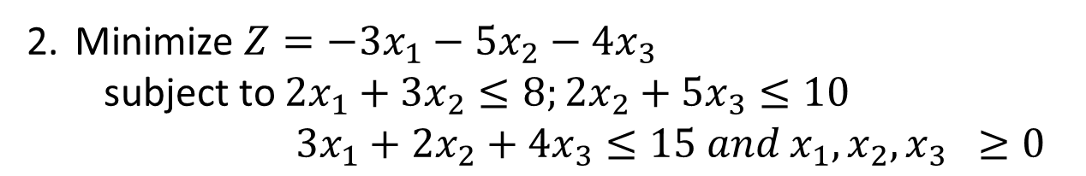
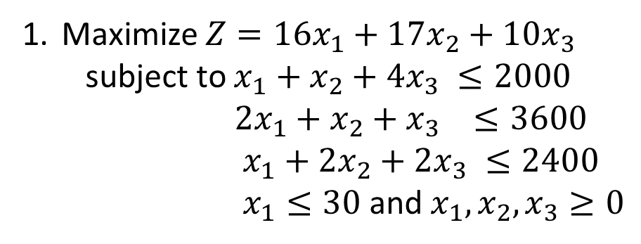
PRACTICE PROBLEMS
Maximize $Z=16x_{1}+17x_{2}+10x_{3}$
subject to $x_{1}+x_{2}+4x_{3} ≤2000$
$2x_{1}+x_{2}+x_{3} ≤3600$
$x_{1}+2x_{2}+2x_{3} ≤2400$
$x_{1}≤30$ and $x_{1}, x_{2}, x_{3}≥0$
Minimize $Z=−3x_{1}−5x_{2}−4x_{3}$
subject to $2x_{1}+3x_{2}≤8;2x_{2}+5x_{3}≤10$
$3x_{1}+2x_{2}+4x_{3}≤15 and x_{1}, x_{2}, x_{3} ≥0$

